Slide 1

Enhancing Decision-Making under Uncertainty: A TRIZ-Inspired Robust Optimization Framework with Machine Learning
Author: Ting-Yu Liao, Vicky Pratama Putra, Chih-Hua Hsu, Hsin Rau
Presenter: Ting-Yu Liao
Date: 2025/01/18
Chung Yuan Christian University

Slide 2
Outline
Introduction
Problem-solving through TRIZ
Problem formulation
Inventive principle #12
Inventive principle #40
Inventive principle #35
Numerical experiment
Result
Conclusion

Slide 3

Introduction
Imagine you are a decision-maker but don’t know what will happen tomorrow…
How many to order…?
How many to store…?
How many to produce…?
How many products will be needed…?
*Image generated by Microsoft Copilot.

Slide 4

Introduction
Due to the uncertain demand, your brain will explode because you really don't know how to make the decision...
Resolve the problem of the manager not being able to make an appropriate decision to increase service level due to uncertain demand!!
*Image generated by Microsoft Copilot.

Slide 5

Problem-solving through TRIZ
Simple analysis: What if just increase the production quantity?
To many inventories, the cost is even higher ???
Service Level ☑
IF | Increase the production quantity
THEN | Service level increase
BUT | Too many inventories lead to a higher total cost
*Image generated by Microsoft Copilot.

Slide 6
Problem-solving through TRIZ
Contradiction matrix and inventive principles:
IF | Increase the production quantity
THEN | Service level increase
BUT | Too many inventories lead to a higher total cost
Worsen Improve | [31] Other Harmful Effects Generated by System
[10] Amount of Substance | 35: Parameter Changes 40: Composite Materials 3: Local Quality 12: Equipotentiality

Slide 7
Problem-solving through TRIZ
Solution park:
Main idea
Generic Solution | Specific Solution
12: Equipotentiality | Transform decision-making problem into robust optimization problem.
40: Composite Materials | Implement machine learning method, use historical and predicted data to build uncertainty set used in the robust optimization problem.
35: Parameter Changes | Tune the hyperparameters to achieve an optimal result.
Support idea

Slide 8



Problem formulation
Stage1
Stage2
Stage3
…
Stage $T−2$
Stage $T−1$
Stage $T$
Step 1: Decisions about production quantities need to be made at each stage $t$.
Minimize the total cost!
Step 2: The initial inventory of the next stage will be computed.
Step 3: Consider production cost, holding cost, and backorder cost at each stage.

Slide 9
Inventive Principle #12 (Equipotentiality) Transform decision-making problem into a robust optimization problem.

Slide 10
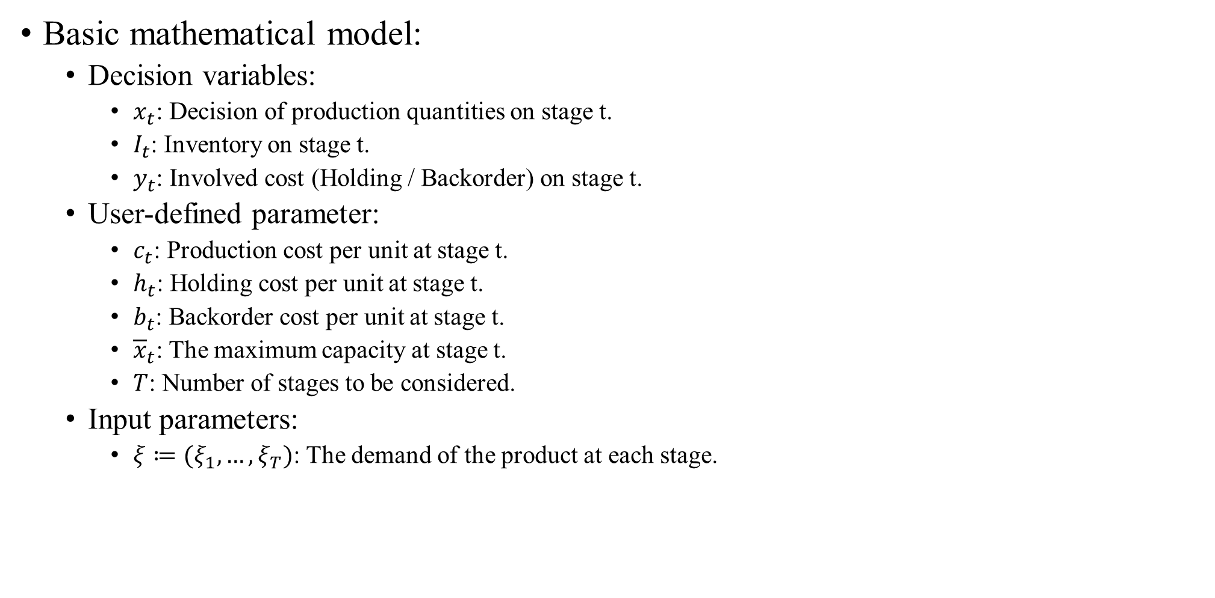
Inventive Principle #12 (Equipotentiality)
Basic mathematical model:
Decision variables:
$x_{t}$: Decision of production quantities on stage t.
$I_{t}$: Inventory on stage t.
$y_{t}$: Involved cost (Holding / Backorder) on stage t.
User-defined parameter:
$c_{t}$: Production cost per unit at stage t.
$h_{t}$: Holding cost per unit at stage t.
$b_{t}$: Backorder cost per unit at stage t.
${\overline{x}}_{t}$: The maximum capacity at stage t.
$T$: Number of stages to be considered.
Input parameters:
$ξ≔(ξ_{1},…,ξ_{T})$: The demand of the product at each stage.

Slide 11
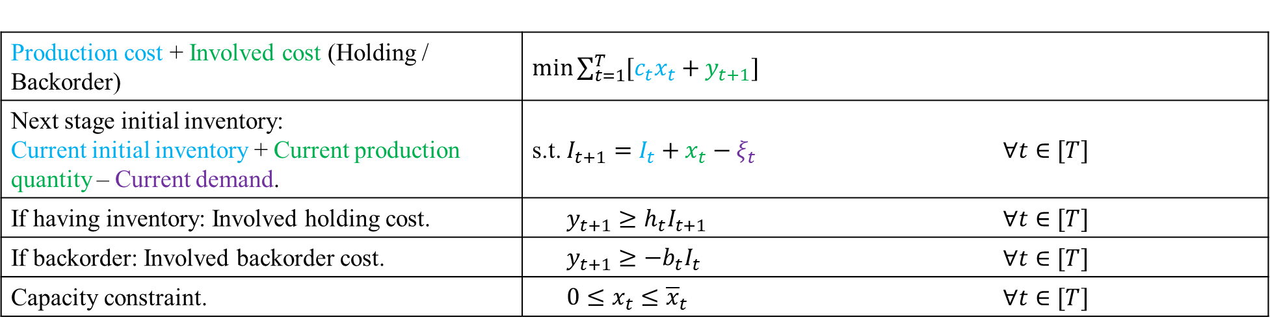
Inventive Principle #12 (Equipotentiality)
Basic mathematical model:
Production cost + Involved cost (Holding / Backorder) | $\min{\sum_{t=1}^{T}{[c_{t}x_{t}+y_{t+1}]}}$
Next stage initial inventory: Current initial inventory + Current production quantity – Current demand. | s.t. $I_{t+1}=I_{t}+x_{t}−ξ_{t}$ | $∀t∈[T]$
If having inventory: Involved holding cost. | $y_{t+1}≥h_{t}I_{t+1}$ | $∀t∈[T]$
If backorder: Involved backorder cost. | $y_{t+1}≥{−b}_{t}I_{t}$ | $∀t∈[T]$
Capacity constraint. | $0≤x_{t}≤{\overline{x}}_{t}$ | $∀t∈[T]$

Slide 12
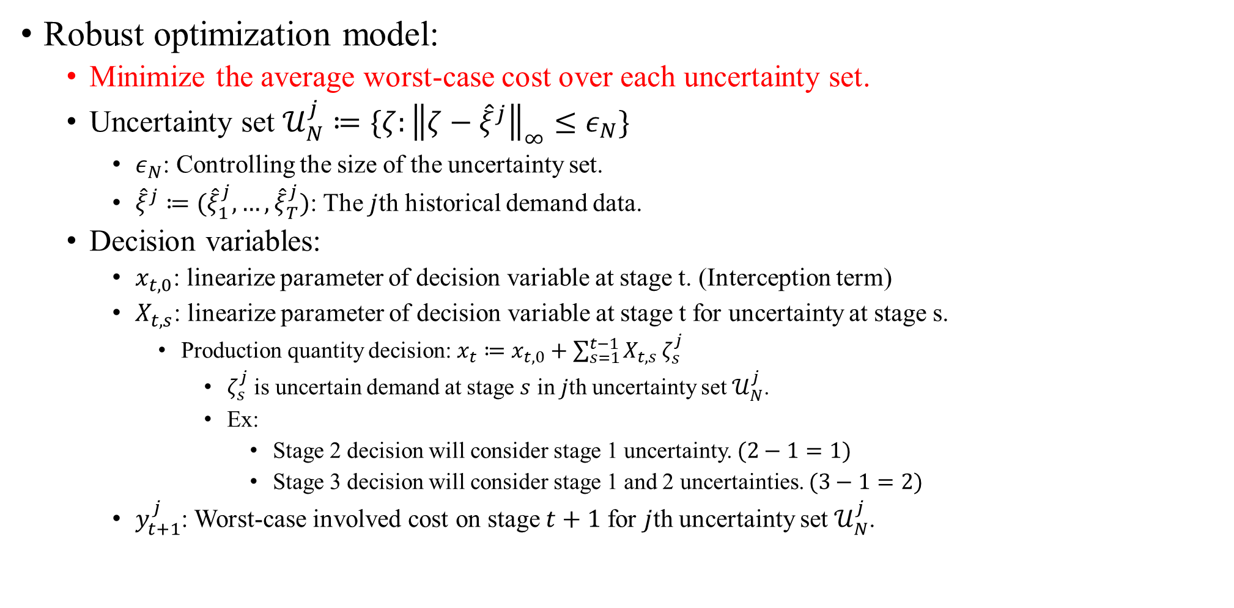
Inventive Principle #12 (Equipotentiality)
Robust optimization model:
Minimize the average worst-case cost over each uncertainty set.
Uncertainty set $𝒰_{N}^{j}≔\{ζ:{\left\|ζ−{\hat{ξ}}^{j}\right\|}_{∞}≤ε_{N}\}$
$ε_{N}$: Controlling the size of the uncertainty set.
${\hat{ξ}}^{j}≔({\hat{ξ}}_{1}^{j},…,{\hat{ξ}}_{T}^{j})$: The $j$th historical demand data.
Decision variables:
$x_{t, 0}$: linearize parameter of decision variable at stage t. (Interception term)
$X_{t,s}$: linearize parameter of decision variable at stage t for uncertainty at stage s.
Production quantity decision: $x_{t}≔x_{t, 0}+\sum_{s=1}^{t−1}{X_{t,s}}ζ_{s}^{j}$
$ζ_{s}^{j}$ is uncertain demand at stage $s$ in $j$th uncertainty set $𝒰_{N}^{j}$.
Ex:
Stage 2 decision will consider stage 1 uncertainty. $(2−1=1)$
Stage 3 decision will consider stage 1 and 2 uncertainties. $(3−1=2)$
$y_{t+1}^{j}$: Worst-case involved cost on stage $t+1$ for $j$th uncertainty set $𝒰_{N}^{j}$.

Slide 13
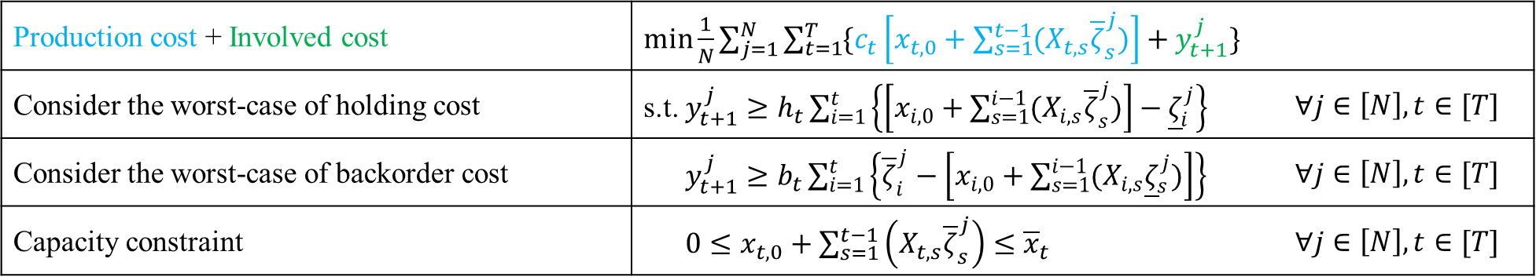
Inventive Principle #12 (Equipotentiality)
Robust optimization:
Minimize the average cost of the worst-case situation.
Production cost + Involved cost | $\min{\frac{1}{N}\sum_{j=1}^{N}{\sum_{t=1}^{T}{\{c_{t}\left[x_{t, 0}+\sum_{s=1}^{t−1}{(X_{t,s}{\overline{ζ}}_{s}^{j})}\right]+y_{t+1}^{j}\}}}}$
Consider the worst-case of holding cost | s.t. $y_{t+1}^{j}≥h_{t}\sum_{i=1}^{t}{\left\{\left[x_{i, 0}+\sum_{s=1}^{i−1}{(X_{i,s}{\overline{ζ}}_{s}^{j})}\right]−{\underline{ζ}}_{i}^{j}\right\}}$ | $∀j∈\left[N\right],t∈[T]$
Consider the worst-case of backorder cost | $y_{t+1}^{j}≥b_{t}\sum_{i=1}^{t}{\left\{{\overline{ζ}}_{i}^{j}−\left[x_{i, 0}+\sum_{s=1}^{i−1}{(X_{i,s}{\underline{ζ}}_{s}^{j})}\right]\right\}}$ | $∀j∈\left[N\right],t∈[T]$
Capacity constraint | $0≤x_{t, 0}+\sum_{s=1}^{t−1}{\left(X_{t,s}{\overline{ζ}}_{s}^{j}\right)}≤{\overline{x}}_{t}$ | $∀j∈\left[N\right],t∈[T]$
Reference:
Dimitris Bertsimas, Shimrit Shtern, Bradley Sturt (2023) A Data-Driven Approach to Multistage Stochastic Linear Optimization. Management Science 69(1):51-74. https://doi.org/10.1287/mnsc.2022.4352

Slide 14
Inventive Principle #40 (Composite Materials) Implement machine learning method, use historical and predicted data to build uncertainty set used in the robust optimization problem.

Slide 15
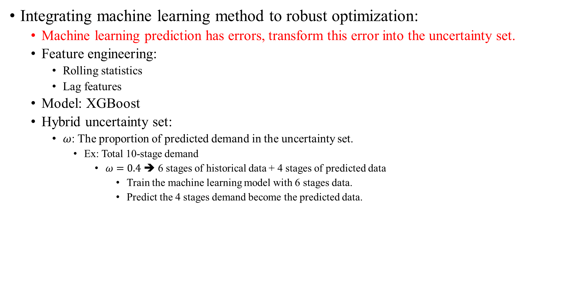
Inventive principle #40 (Composite Materials)
Integrating machine learning method to robust optimization:
Machine learning prediction has errors, transform this error into the uncertainty set.
Feature engineering:
Rolling statistics
Lag features
Model: XGBoost
Hybrid uncertainty set:
$ω$: The proportion of predicted demand in the uncertainty set.
Ex: Total 10-stage demand
$ω=0.4$ ➔ 6 stages of historical data + 4 stages of predicted data
Train the machine learning model with 6 stages data.
Predict the 4 stages demand become the predicted data.

Slide 16
Inventive Principle #35 (Parameter Changes) Tune the hyperparameters to achieve an optimal result.

Slide 17

Inventive principle #35
Use the grid search method to find the optimal hyperparameter set:
Finding the hyperparameter set that can minimize the testing cost.
Hyperparameters:
The size of uncertainty set: $ε_{N}={10}^{−3} to {10}^{1}$ in log space.
The proportion of predicted demand in the hybrid data: $ω=\{0,0.1,…,0.7\}$
Machine learning model parameter: n_estimators $=\{10, 20, 30, 40, 50, 100, 150\}$
Machine learning model parameter: max_depth $=\{5, 10, 15\}$

Slide 18
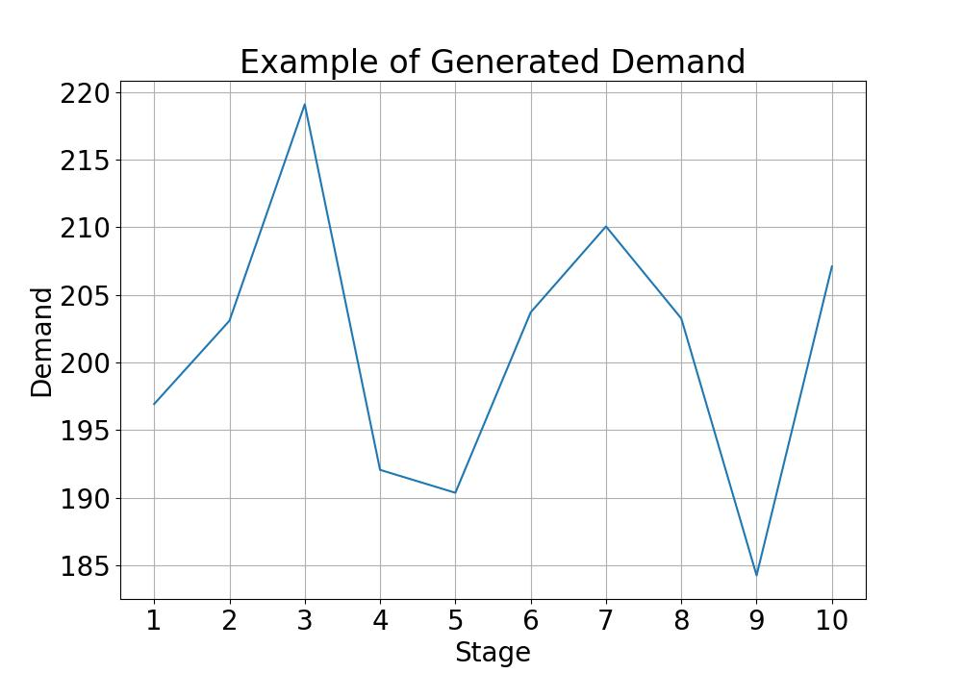
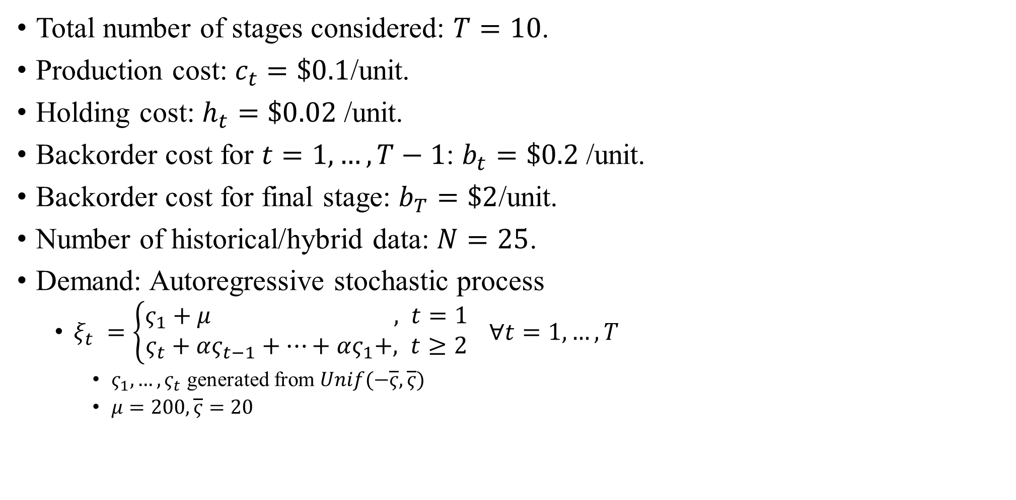
Numerical experiments
Total number of stages considered: $T=10$.
Production cost: $c_{t}=\$0.1$/unit.
Holding cost: $h_{t}=\$0.02$/unit.
Backorder cost for $t=1, …, T−1$: $b_{t}=\$0.2$/unit.
Backorder cost for final stage: $b_{T}=\$2$/unit.
Number of historical/hybrid data: $N=25$.
Demand: Autoregressive stochastic process
$ξ_{t} =\left\{\begin{aligned}ς_{1}+μ , t=1 \\ ς_{t}+ας_{t−1}+…+ας_{1}+&, t≥2\end{aligned}\right. ∀t=1,…,T$
$ς_{1},…,ς_{t}$ generated from $Unif(−\overline{ς},\overline{ς})$
$μ=200,\overline{ς}=20$

Slide 19
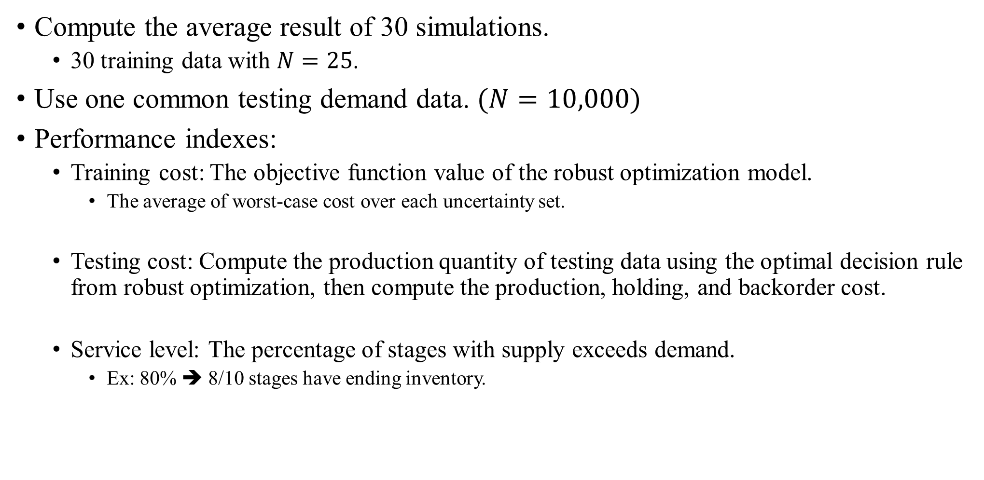
Numerical experiments
Compute the average result of 30 simulations.
30 training data with $N=25$.
Use one common testing demand data. $(N=10,000)$
Performance indexes:
Training cost: The objective function value of the robust optimization model.
The average of worst-case cost over each uncertainty set.
Testing cost: Compute the production quantity of testing data using the optimal decision rule from robust optimization, then compute the production, holding, and backorder cost.
Service level: The percentage of stages with supply exceeds demand.
Ex: 80% ➔ 8/10 stages have ending inventory.
Training: historical demand, used to train the model.
Testing: future demand, used to evaluate the model.

Slide 20
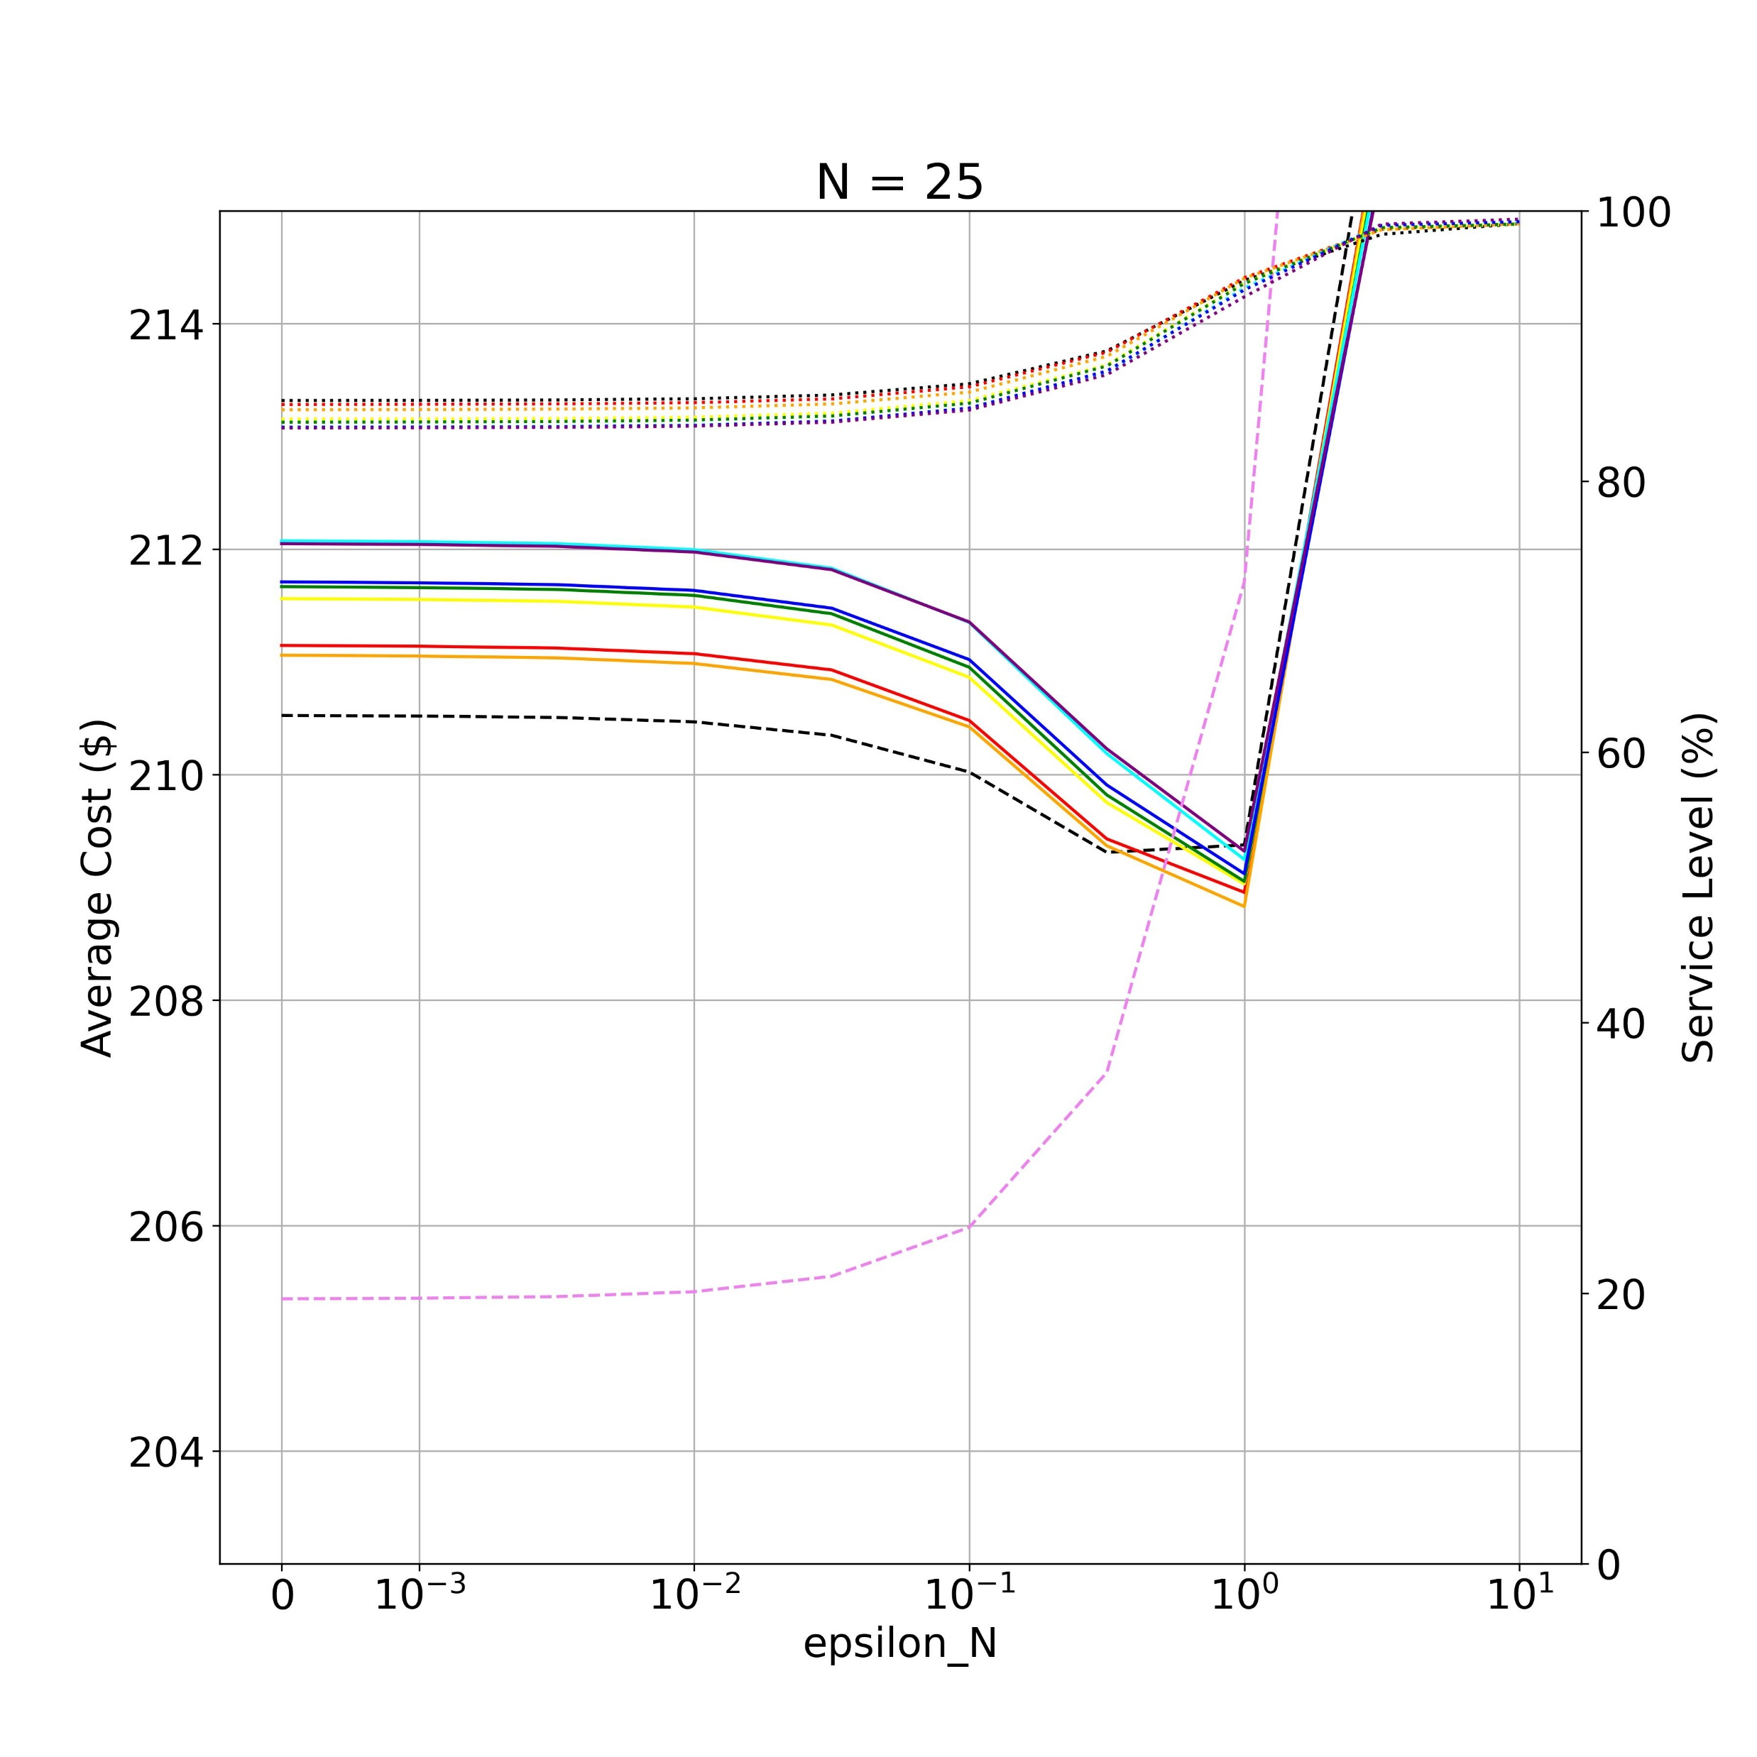
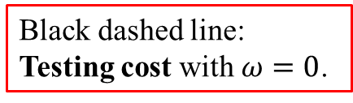
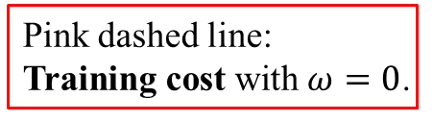
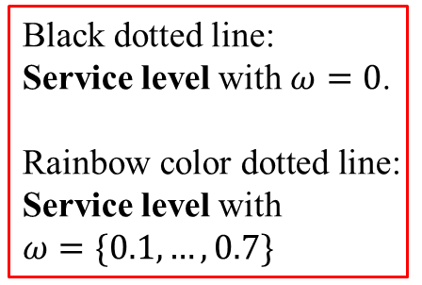
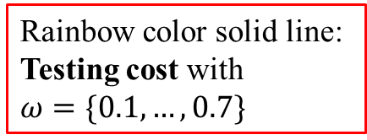
Result
Black dotted line:
Service level with $ω=0$.
Rainbow color dotted line:
Service level with
$ω=\{0.1,…,0.7\}$
Rainbow color solid line:
Testing cost with
$ω=\{0.1,…,0.7\}$
Black dashed line: Testing cost with $ω=0$.
Pink dashed line: Training cost with $ω=0$.
Small uncertainty set.
Without robustness.
Big uncertainty set. ➔
With robustness.

Slide 21
Result
No robustness: Only make the decision based on the historical demand. ➔ Overfitting.
Training costs are low, but testing costs are high.
Service levels are also lower.
Small uncertainty set.
Without robustness.
Big uncertainty set. ➔
With robustness.

Slide 22
Result
Uncertainty set too big: Consider too much worst-case.
➔ Underfitting.
Service levels can reach almost 100%.
Both training and testing costs are very high.
Small uncertainty set.
Without robustness.
Big uncertainty set. ➔
With robustness.

Slide 23
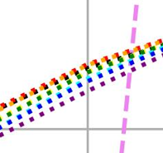
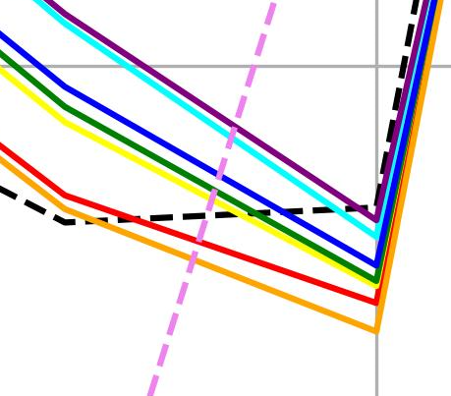
Result
#35 Parameter Changes:
Selecting an appropriate hyperparameters is needed.
#40 Composite Materials: Using hybrid uncertainty set can achieve a higher service level and lower testing cost.
Small uncertainty set.
Without robustness.
Big uncertainty set. ➔
With robustness.

Slide 24
Conclusion
This study integrates the TRIZ method, robust optimization, and machine learning to propose an innovative inventory management method.
When the future demand is uncertain, the proposed method can:
Make a robust decision that results in a higher service level and lower total cost.
Highly practical since it can be applied to any manufacturing and retail industry.

Slide 25
Thank you.

